Slide 1
Prediction of FinFET Current-Voltage and Capacitance-Voltage curves using Machine Learning with Autoencoder Kashyap Mehta and Hiu-Yung Wong , Senior Member, IEEE
Consolidated By:
Aakanksha Gupta
Computer Engineering Department
San Jose State University

Slide 2
Problem Statement and Overall Strategy
Objective: Predicting full transistor current-voltage(IV) and capacitance-voltage(CV) using machine learning.
Overall Strategy: Parameters* collected of transistor are exposed to an auto encoder to perform efficient coding of signals. Encoded signal is then sent to a 3rd order polynomial regression model to allow accurate prediction. In the third and final part, in order to improve the results, noise filtering is used.
*To generate IV/CV data, the gate length(Lg), fin top width(Wtop) and gate metal workfunction(Wf) are varied randomly and independently in the ranges of 15nm-25nm, 5nm-15nm and 4.4eV-4.7eV respectively

Slide 3
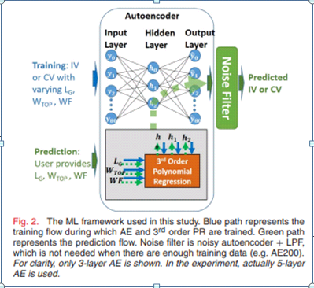
Architecture

Slide 4
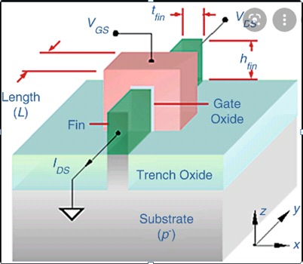
Data Source(FinFET transistor)

Slide 5
Data Size
Testing done on 3 machines, to study the effects
of training curves. 1. AE200
2. AE50
3. AE25
*AE denotes Autoencoder

Slide 6
Parameters required in each Step
Step 1: Auto encoder
Step 2: Polynomial Regression
Inputs of AE are Standard scalar logarithmic values.
5 layers using RELU for activation.
First and last hidden layer have 40 nodes and middle hidden layers has 3 hidden nodes.
The number of hidden nodes is set to 3 because of the variations in the curves are caused by 3 parameters (Lg, Wtop, Wf).
Degree of Freedom = 3
Step 3: Noise Filtering
Noise Auto encoder + Low Pass Filter

Slide 7
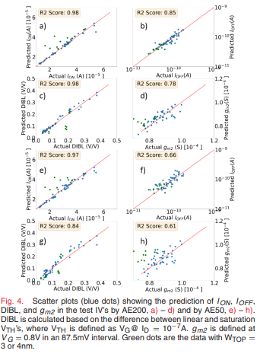
Results
Scatter plot denotes the results between coefficient of determination and Ion, Ioff, DIBL and gm2(1st derivative of curve).
By reducing the training data to only 50(AE50) it still captures features although with large error.

Slide 8
Conclusion
AE can be used to capture relationship between design parameters and IV/CV curves with as few as 25-50 training curves.
No domain knowledge is required for establishing this relationship.

Slide 9
Future Prospects
From underlying paper, it is expected that same methodology can be used to understand novel devices through training with limited experimental data before the underlying physics is understood.

